Slide 1



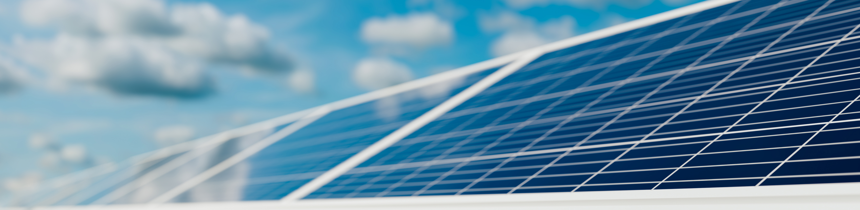
The Impact of Floating PhotoVolatic Cells on Phytoplankton Communities in a Freshwater Loch
A Modelling Dissertation using the General Lake Model (GLM)
Ariel Koh
s2227491@ed.ac.uk
7 October 2024

Slide 2
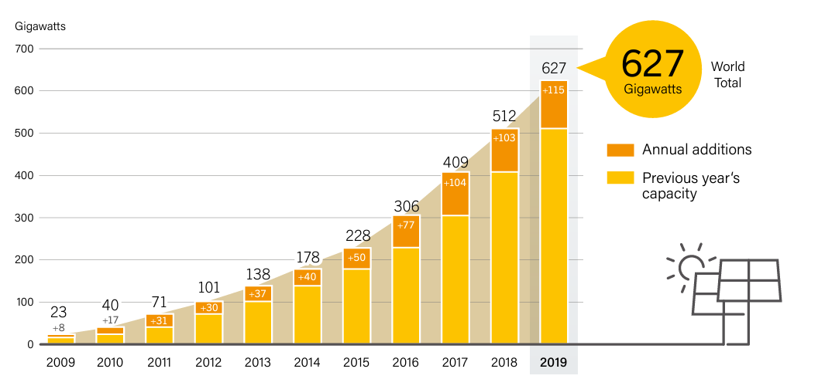
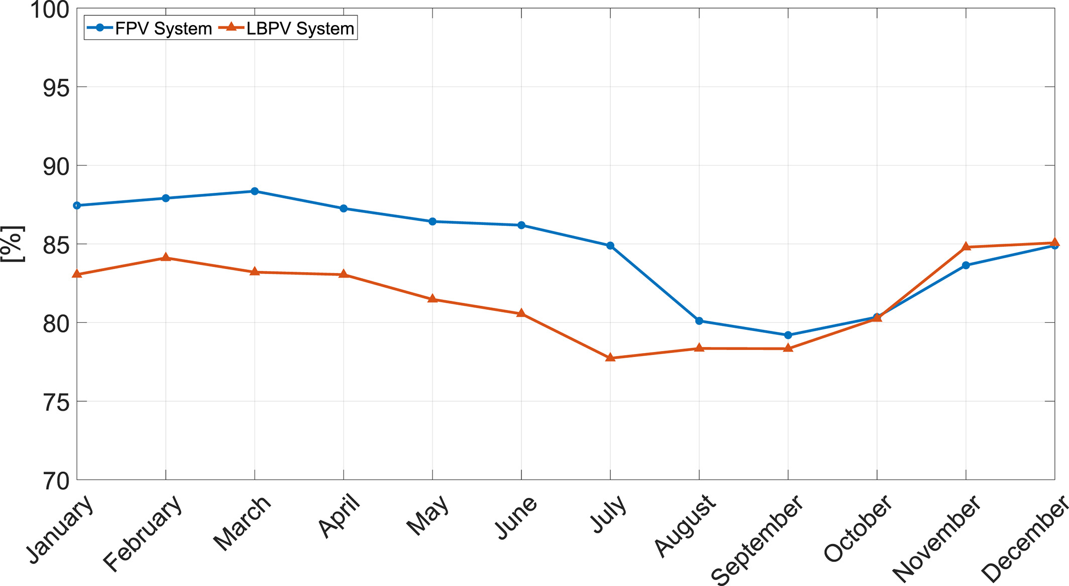
Background Information
Figure 1: Solar PV Global Capacity and Annual Additions,
2009-2019 (REN21, 2020)
Figure 2: Performance ratio for both floating photovoltaic (FPV) and land-based photovoltaic (LBPV) systems
(Golroodbari & van Sark, 2020)
Notes:
Chlorine reacts with organic compounds in untreated water to form compounds known as disinfection byproducts. Disinfection byproducts include chloramines and known and suspected human carcinogens such as bromodichloromethane and chloroform.

Slide 3
Background Information
Disinfection Byproducts (DBP)
Trihalomethanes (THMs)
Haloacetic Acids (HAAs)
Death
Disinfection process
Increase in phytoplankton abundance
Increase in DOM
Halogenation
Presence of
heavy metals
DOM and heavy metal bounded compounds
Iron
Lead
Mercury

Slide 4
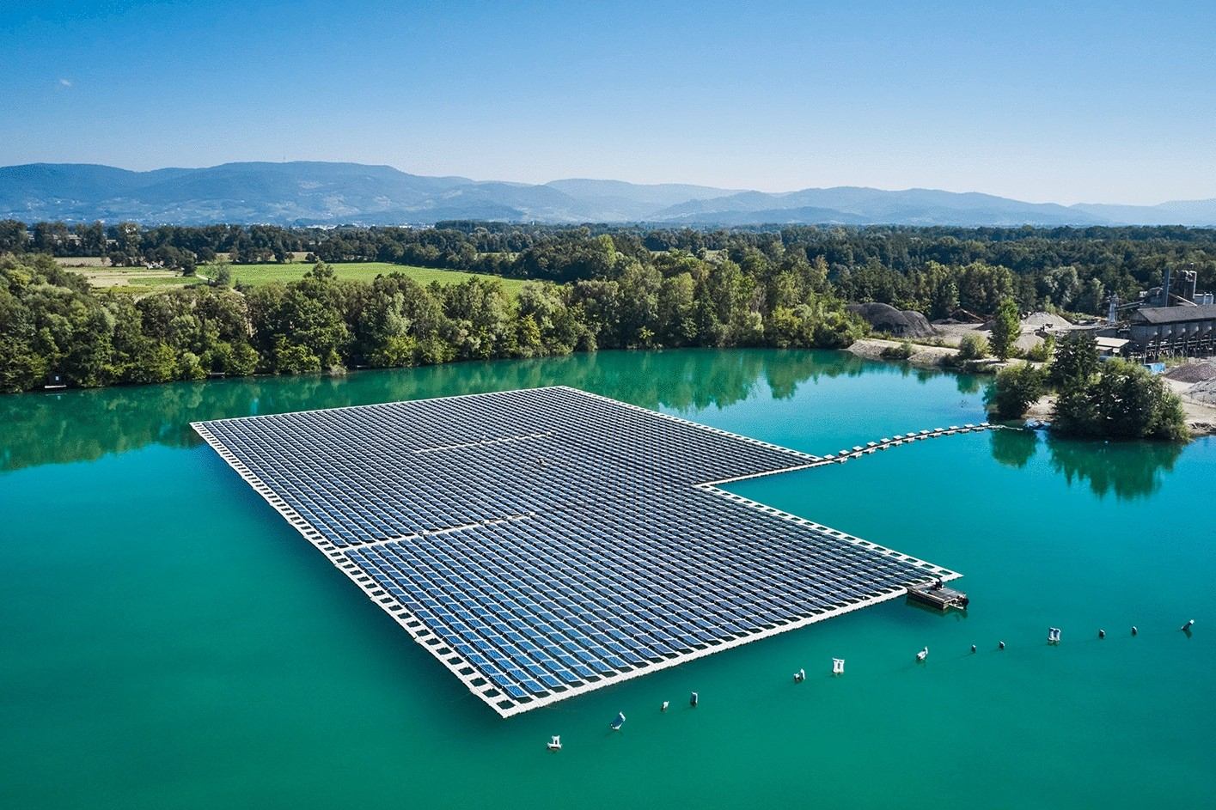
Aim & Research Questions
AIM: To understand the impact of floating photovoltaic (FPV) cells on phytoplankton communities in shallow freshwater lakes.
RESEARCH QUESTIONS:
How does varying the coverage of FPV affect phytoplankton abundance and the risk of algal bloom?
How does changes in PFV affect water quality and nutrient partitioning (metals & dissolved organic matter) in the lake?

Slide 5

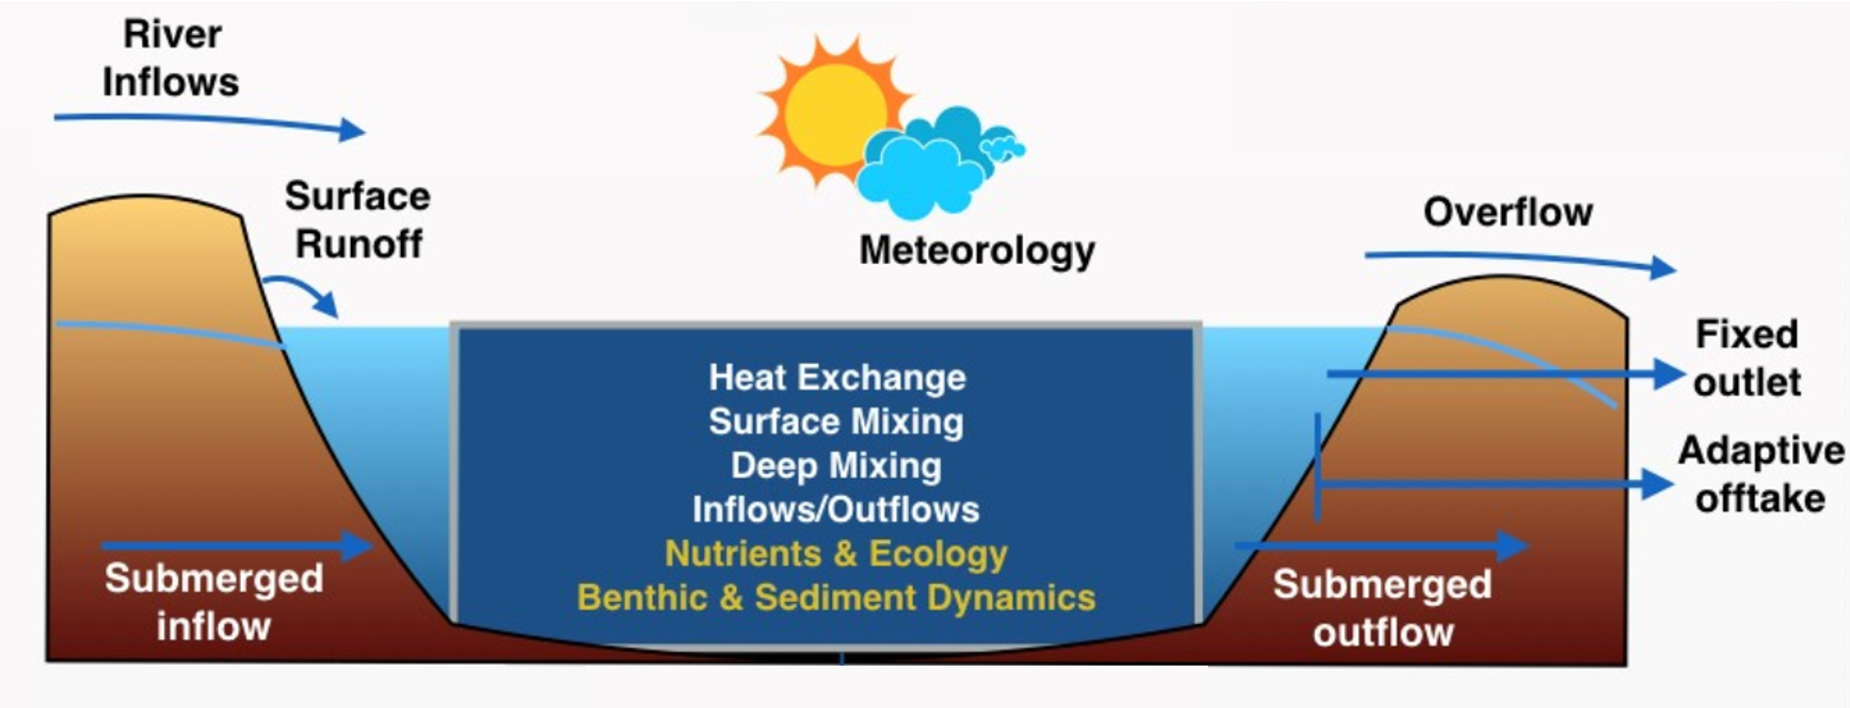
Methods
Model Configuration (Switches & Parameters) Input
Model Output Files
GLM setup parameters
Meteorological Forcing Options
Output Summary
Overflow
Starting Condition
Energy Balance Summary
Inflow Forcing Options
Output at Specific Height
Lake Morphometry
Output Options
Water Quality Model Options
GLM
Outlet: Chosen output attributes
Outflow Forcing Options
Combined Outlet: Sum of outflow and overflow
Time-series (Boundary Condition) Input
Meteorological data
Outflow data
Inflow data

Slide 6
Data Analysis
glm (PhytoplanktonAbundance~Coverage, family = poisson(link = "log"), data=data)
lm (expDOMconcentration~Coverage, data=data)
Figure 3: Dummy graph of Phytoplankton Abundance against FPV Coverage
Figure 4: Dummy graph of DOM Concentration
against FPV Coverage

Slide 7
QUESTIONS?
Ariel Koh
s2227491@ed.ac.uk
7 October 2024

Slide 8
References
Golroodbari, S.Z. and van Sark, W. (2020) ‘Simulation of performance differences between offshore and land‐based Photovoltaic Systems’, Progress in Photovoltaics: Research and Applications, 28(9), pp. 873–886. doi:10.1002/pip.3276.
REN21, 2020. Renewables 2020 Global Status Report. Paris.
Other notable sources:
de Tezanos Pinto, P., Allende, L. and O’Farrell, I. (2006) ‘Influence of free-floating plants on the structure of a natural phytoplankton assemblage: An experimental approach’, Journal of Plankton Research, 29(1), pp. 47–56. doi:10.1093/plankt/fbl056.
Exley, G. et al. (2021) ‘Floating photovoltaics could mitigate climate change impacts on water body temperature and stratification’, Solar Energy, 219, pp. 24–33. doi:10.1016/j.solener.2021.01.076.
Haas, J. et al. (2020) ‘Floating photovoltaic plants: Ecological impacts versus hydropower Operation Flexibility’, Energy Conversion and Management, 206, p. 112414. doi:10.1016/j.enconman.2019.112414.
Ziar, H. et al. (2020) ‘Innovative floating bifacial photovoltaic solutions for Inland Water Areas’, Progress in Photovoltaics: Research and Applications, 29(7), pp. 725–743. doi:10.1002/pip.3367.

